Slide 1

Records Management
USEEP Training
Leadership and Management of Institutions
Theme 1: Day

Slide 2
Outline
Definitions
Records Lifecycle/Phases
Importance of Records Management
Best practices
Challenges in Records Management
Principles of Records Management

Slide 3
Definitions
A record is a collection of data that is organized in a group of fields within a table that are related to a particular topic or category.
A record is also used to refer to the writing or document that is the preserved account of something.
A record is a document, data, set of data that is created or received in the course of an organization's business that: has Structure, that is the physicality and internal organization of the Content.
Types of records in a school setting may include: financial records, medical records, legal records, and personnel records. etc
Other Records in schools: Class discussion

Slide 4
Importance of Records Management
Compliance: Ensuring legal and regulatory compliance.
Efficiency: Improving efficiency and reducing storage costs.
Risk Management: Mitigating risks associated with data breaches and loss.
Good governance,
Effective and efficient administration.
Forms the basis for formulating policy ,managing resources and delivering services to the public.
Records Management also provides a basis for accountability and protecting the rights of individuals.

Slide 5
Record management
Records management is the control and maintenance of both digital and hard copy documentation of transactions and business activity, also known as records. It is the systematic control of records throughout their lifecycle.“

Slide 6
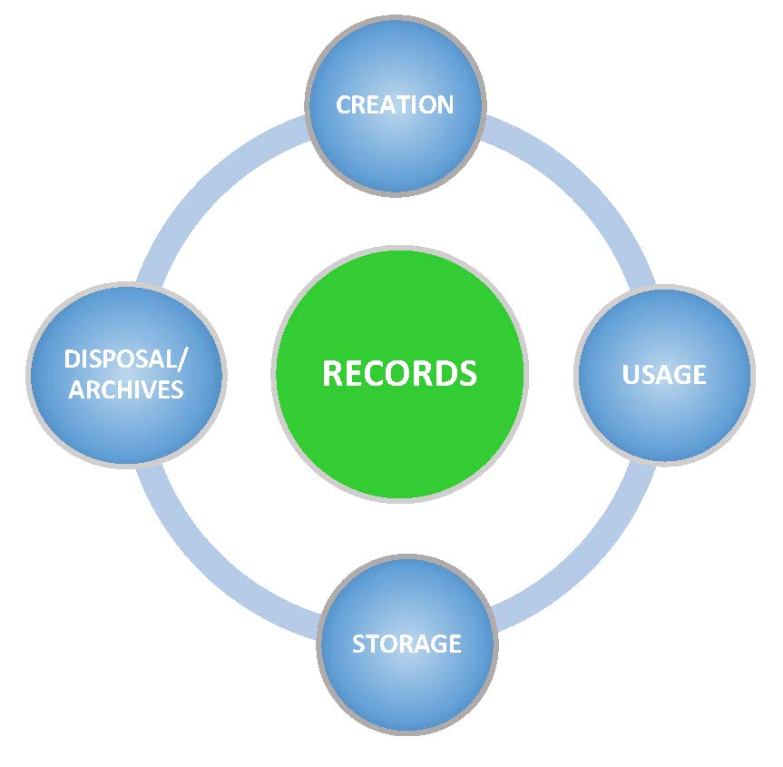
Records Life cycle Phases:
.
Creation/identification
Usage
Storage
Disposal/Archiving

Slide 7
Class interaction on the lifecycle
Class discussion on the Management of the records Lifecycle .
This should be guided by the slides that follow

Slide 8

Creation
How are records created in your schools ?
How are records classified?

Slide 9

Usage
Who uses the school records ?
How are records used in your schools?

Slide 10
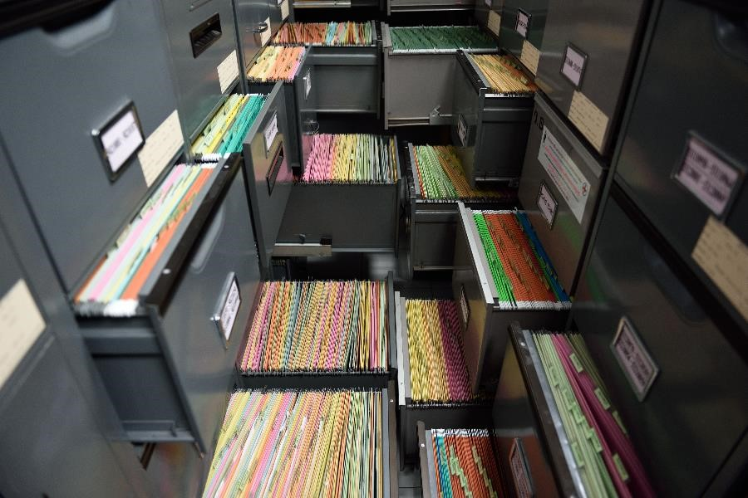
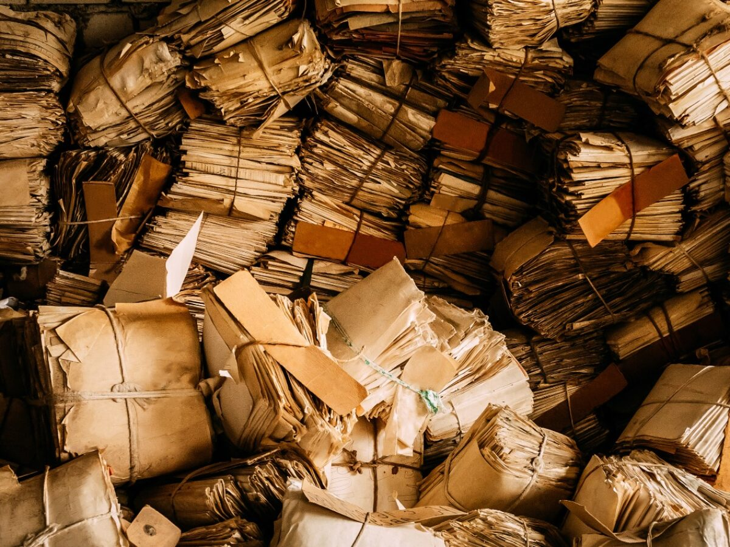
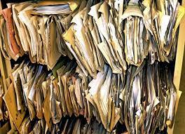
How are records Stored in your schools

Slide 11

Disposal
How are Records disposed ?

Slide 12
The life cycle therefore includes
Creating complete and accurate records that provide evidence of the organization’s functions, activities, decisions, transactions, procedures, etc.
Identify and apply an appropriate security classification for the different records
Distinguish between records and non-record copies or working documents, to be able to appropriately segregate them in the filing system.
Place the record in an organizational classification scheme (or file plan) either in paper (e.g. in a filing cabinet or a binder) or in electronic version (e.g. on a shared drive or in a system) to ensure that it’s preserved within its context.

Slide 13
Cot’d
6. Preserve the integrity of the record, which means ensuring that it has not been altered or cannot be altered after completion.
7.Maintain its usability which means making it available for all colleagues who need an access to the record to do their job.
8. Facilitate identification and preservation of records with permanent retention.
9. Identify the records that are not required to be stored in the primary office space (paper) or systems/shared drives (electronic).
10. Transfer them to the local Records Center but make sure you can retrieve only those records that are needed from time to time.

Slide 14
Cotd
11. Identify records with archival value (permanent retention), list them, organize them and sent them to the archives.
12. Identify records due for disposal/destruction, list them, gather necessary approvals for the destruction and proceed with an environmentally friendly destruction process.

Slide 15
Records Management Instruments
Records Policy :-a set of rules to regulate or manage records through their lifecycle in an organization.
Records procedures Manual;-Process or methods involved is the records lifecycle from creation, usage and maintenance, to destruction or archival preservation.
Retention and Disposal schedule:- A list or groups of records (record series) created, received, and used by a school along with information on how long to keep them and when to dispose them.

Slide 16
Common problems in records management
Insecure Records Storage.
Inability to Locate Records.
Managing Secure Access.
Records Retention Scheduling.
An Evolving Regulatory Environment

Slide 17
Challenges in Records Management
Managing large volumes of records.
Compliance: Keeping up with changing regulations.
Digital Transformation: Transitioning from paper to digital records.
Data breaches,
Loss of sensitive information,
Inadequate document disposal,
Non-compliance with regulations,
Insufficient data backup procedures.

Slide 18
Principles of records Management
Authentic/ integrity .It must be possible to prove that records are what they purport to be and who created them, by keeping a record of their management through time.
Accurate.
Accessible.
Complete.
Comprehensive.
Compliant.
Effective.
Secure.

